Slide 1
moov Detect Bad Roads using ML(CNN)
Streetsmart Hackathon – Data Driven Road Safety and Mobility

Slide 2
What problems do potholes and bad road-infra pose?
The deteriorating condition of road infrastructure due to the presence of potholes has become a pressing concern in urban and rural areas alike. Potholes, which result from a combination of factors such as weathering, heavy traffic, and inadequate maintenance, pose significant risks to public safety, traffic-jams, vehicular integrity, and the overall quality of transportation systems.
The lack of timely identification and effective repair of potholes has led to increased accidents, vehicle damage, traffic congestion, and elevated maintenance costs for both local authorities and vehicle owners.
Addressing the issue of potholes requires innovative and sustainable solutions that encompass efficient detection methods, timely repairs, and long-lasting road construction practices to ensure safer and more resilient road networks for the community.

Slide 3
How moov plans to resolve this issue?
The Pothole Detection System is an innovative machine learning project aimed at automatically identifying and classifying potholes on roads. The system utilizes computer vision techniques and deep learning algorithms to analyze images, videos and variations captured by sensors and cameras installed on vehicles or fixed locations. Using vehicle cameras and sensors helps in saving cost.
Key Features:
Data Collection: A dataset comprising images of road surfaces is collected from various sources, including vehicle-mounted cameras(eg: parking cams, dashcams and sensors) and traffic monitoring cameras. The dataset is annotated to label potholes and non-pothole regions.
Real-time Detection: To facilitate real-time applications, the system is optimized for efficient processing. The model can be deployed on edge devices or embedded within vehicles, enabling immediate detection of potholes as the vehicle traverses the road.
Alerts and Reporting: When a pothole is detected by say more than 100 vehicles(sample figure, actual can differ) in an hour, the system will trigger alerts for the driver, road maintenance teams, or local authorities. Additionally, the system will generate report with information about pothole location.

Slide 4
Benefits
Enhanced Road Safety: Swift identification of potholes helps prevent accidents, vehicle damage, and discomfort to passengers.
Efficient Maintenance: Local authorities can prioritize and plan road repair activities based on real-time data.
Cost Savings: Timely repairs and reduced vehicle damage lead to cost savings for both drivers and road maintenance departments.
Data-driven Insights: Aggregated data on pothole occurrences can be analyzed to identify trends and patterns for proactive road maintenance.

Slide 5
Architecture
We plan to save short recordings, scan those and if a bad-road is identified then save the location locally.
When the vehicle is connected to the internet then these details can be saved in the cloud.
To optimize storage we can clear recordings, local data from the vehicle/device and after the status is changed to “fixed” then from cloud storage too and only keeping some meta-data and data snapshots.
Example:
{
"latitude": lat,
"longitude": long,
"road_condition":prediction,
"vehicle_registration_number":1234, // for compliance
"area": addr,
"area_type": "urban", // Needs to be classified from a saved registery
"time_of_capture": time.time()
}

Slide 6
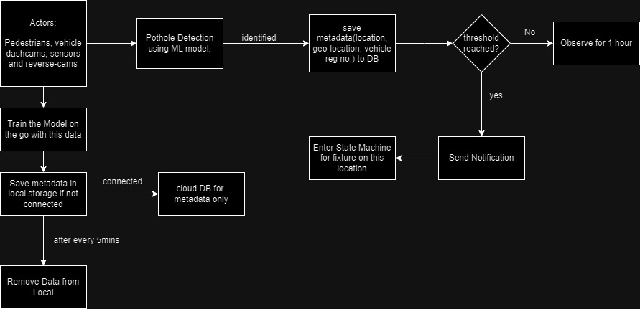
Architecture contd.

Slide 7
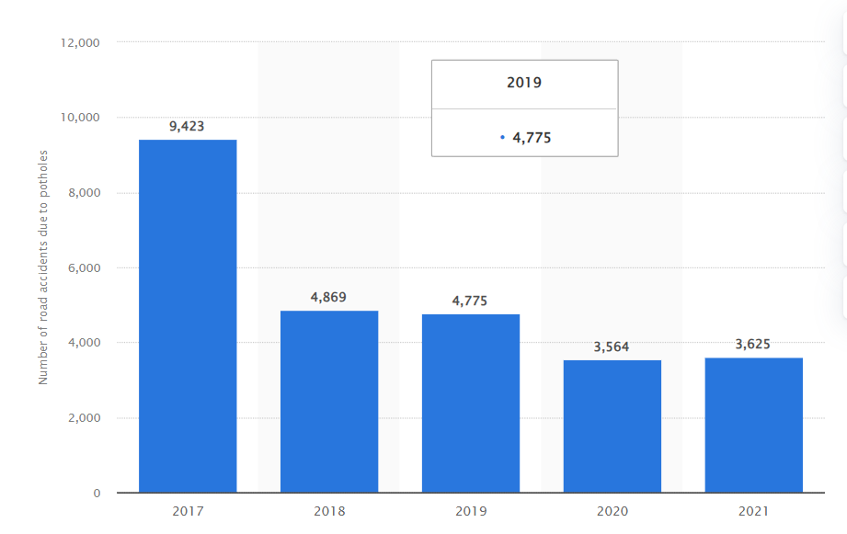
The Real talk
Every year around 3,597 people die due to potholes. More than 30% of people die due to potholes. The Ministry of Road Transport and Highways provided figures that over 9300 deaths, 25000 injured in the last three years due to potholes and more than 25,000 people are getting injured due to potholes. But still, it is not taken as a serious issue in India. Still, potholes are getting originated.
The government said total 4,775 and 3,564 accidents occurred in the years 2019 and 2020, respectively, due to potholes. – livemint

Slide 8
What’s next?
This project plans to expand by involvement of stakeholders like automotive companies that could help integrating software systems in their vehicles; drivers, passengers and pedestrians. We wish to carry this proof of concept currently based on mock response and limited(but good) dataset to be a game changer for our roads.
With the help of our stakeholders:
Government Agencies and Road Authorities: Local, regional, and national government bodies responsible for road maintenance and safety. The
Transportation Departments: Departments that oversee transportation infrastructure and safety would be concerned with implementing technologies that enhance road conditions and reduce accidents. They could potentially fund or support the project.
Drivers and Vehicle Owners: Vehicle operators are directly affected by road conditions, including potholes. The system's ability to alert drivers to the presence of potholes would garner their interest and support.
Vehicle Manufacturers: Car manufacturers could integrate the pothole detection system into their vehicles' safety features, enhancing their market competitiveness and providing additional value to customers.

Slide 9
Stakeholders Contd.
Insurance Companies: Potholes can cause damage to vehicles, leading to insurance claims. Insurance companies might find value in supporting or promoting the implementation of technologies that reduce the frequency of such claims.
Smart City Initiatives: Organizations involved in smart city projects and urban development might see the system as a valuable tool for creating safer and more efficient transportation networks.
Road Maintenance Contractors: Companies responsible for road maintenance and repairs could benefit from the system's data-driven insights to optimize their operations and respond promptly to identified potholes.
General Public: The public at large would benefit from improved road safety and reduced vehicle damage caused by potholes.
We can scale the application up by using better software infra like cloud providers and queueing services to notify and practical applications as well like making the model flexible to even identify badly designed pathways, zebra-crossings , dividers…

Slide 10
Conclusion
As the project evolves, ongoing collaboration with stakeholders will be key to refining the system's accuracy, expanding its capabilities, and enhancing its overall impact. The successful implementation of the Pothole Detection System not only exemplifies the power of machine learning to address practical challenges but also underscores the potential of technology to transform our everyday experiences for the better. With continued innovation and support, this system could set the standard for proactive road maintenance, contributing to a safer and more efficient transportation ecosystem.

